Slide 1



Week 3, Lecture 5
Intro to databases and MySQL

Slide 2
Admin stuff and reminders:
Don’t forget this week’s discussion topics!
https://login.codingdojo.com/d/309/121/1194
https://login.codingdojo.com/d/309/121/1195
Due Sunday night at 11:59 PM Pacific! Don’t fall behind!!
This week’s core assignments - there are four of them:
Dojos and Ninjas (in ERD Lessons)
Books
Dojos and Ninjas (in MySQL Queries)
MySQL Countries
Don’t fall behind on core assignments this week and next!
Remember the 20-minute rule!!

Slide 3
How are you feeling about the OOP material?
1 = Not good
10 = Very good

Slide 4
How are you feeling today?
1 = Not good
10 = Very good

Slide 5
Week 3, Lecture 5 agenda:
Overview of databases
Identifying relationships:
One-to-one
One-to-many
Many-to-many
Database normalization
Database design and creating an entity relationship diagram (ERD)
Data types
Default values - including for created_at and updated_at fields
Primary key
Foreign keys
Cascade on delete (REMEMBER THIS!)
Forward engineering
Fixing columns after engineering (might leave for after lecture)

Slide 6
Introduction to databases
When you log into Coding Dojo’s site - or any other - you must at least once enter your email and password. The same can be said for many other sites, such as Facebook, Gmail, etc.
So how does a site know where that information is stored? That’s where databases come in!
A database is a collection of data that is stored on a persistent - or permanent - basis, which can be found on a machine, which will likely be a computer or server. So your login information is saved in a database. Same with information you share on a social media site like Facebook. Same with posts you make on a blog. The list is endless!

Slide 7

MySQL
SQL (pronounced phonetically, so “S”-”Q”-”L”, or pronounced like “sequel”) is short for Structured Query Language. Versions of SQL are used by many companies for data storage, such as Microsoft, Accenture, Stack Overflow, among countless others.
MySQL is a relational database, meaning that two or more items are related to one another, such as a book and an author. (There are nonrelational databases too, like MongoDB, which you’ll learn in the MERN stack if you’re enrolled in that.)

Slide 8
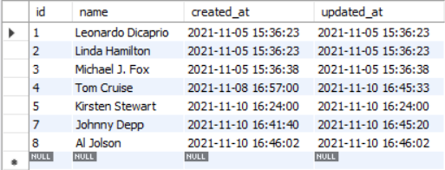
MySQL
Here is what a table in a database of performers might look like:
Each performer is stored in a record, which is an entry in the table above. Visually each record is viewable as a row.
There are 4 columns in the table: id, name, created_at and updated_at.

Slide 9
Identifying relationships
When creating your database, one very essential concept to grasp is how two or more items relate to one another. For example, if you have a database of books and authors, cars and manufacturers, performers and movies, etc., you want to think about how they are connected.
Here’s a real-life example: when you’re using Facebook, you - the logged in user - have many friends. But each friend can be connected to many other users. This is an example of a many-to-many relationship.
The following slides will guide you in deciding what kinds of relationships your database will utilize.

Slide 10
Identifying relationships
Think about two items that are connected to each other. The example we’ll use here is cars and manufacturers.
Here are two important questions you should ask yourself:
Can one of X have many of Y?
Can one of Y have many of X?
Using our example:
Can one car have many manufacturers?
Can one manufacturer have many cars?

Slide 11
Identifying relationships
Think about two items that are connected to each other. The example we’ll use here is cars and manufacturers.
Here are two important questions you should ask yourself:
Can one of X have many of Y?
Can one of Y have many of X?
Using our example:
Can one car have many manufacturers? NO
Can one manufacturer have many cars? YES
Because one answer is YES and the other is NO, this is a one-to-many relationship.

Slide 12
Identifying relationships
Using the same two general questions:
Can one of X have many of Y?
Can one of Y have many of X?
If the answer to those questions is:
NO to both: this is a one-to-one relationship
YES to one, NO to the other: this is a one-to-many relationship
YES to both: this is a many-to-many relationship

Slide 13
Question 1
Identify the relationship with these examples:
A book and author
A driver and a license
A performer and a movie
A naval ship and a sailor

Slide 14
Question 1
Identify the relationship with these examples:
A book and author - many-to-many; books can have many authors
A driver and a license - one-to-one; no driver should have 2 licenses
A performer and a movie - many-to-many
A naval ship and a sailor - one-to-many - a sailor can’t be assigned to 2 ships

Slide 15
Database normalization
When designing, you don’t want to repeat yourself where possible. (This is the same guiding principle when dealing with OOP and with creating functions - to avoid repeating code.)
There are 3 forms of database normalization:
First form: No single column should have multiple values. For example, having a list of cars in one column for a table of manufacturers - this violates the first form.
Second form: Each column should have unique values. (There will be some exceptions, like first name, last name, etc.) So imagine a database of literary characters with a column for book titles. The book title will likely be duplicated, so we should have a table for books instead.
Third form: Don’t have two or more columns dependent on a non-key column (i.e. a primary or foreign key; more on those keys later). For example, a manufacturer and headquarters locale in a table of cars - those two columns depend on each other.

Slide 16
Database design
You will be building what’s called a schema, which contains details on what you want to store in your database.
A lot of people underestimate the importance of designing a database, which leads to projects not getting off the ground!
Think about what information you want to store in your database AND how items connect to one another through relationships.
For example, let’s say you have cars and manufacturers. This is a one-to-many relationship. If you have other items, make sure you identify the appropriate relationships among them.
Now think about what information you want to store. For cars, you might want door count, engine size, the model name, etc. Manufacturers could contain information about the name of the company, the city where its headquarters are located at, the year it was founded, how big is the workforce, etc.

Slide 17
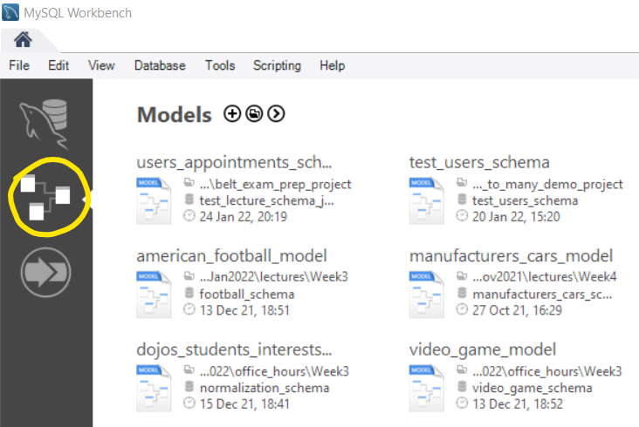
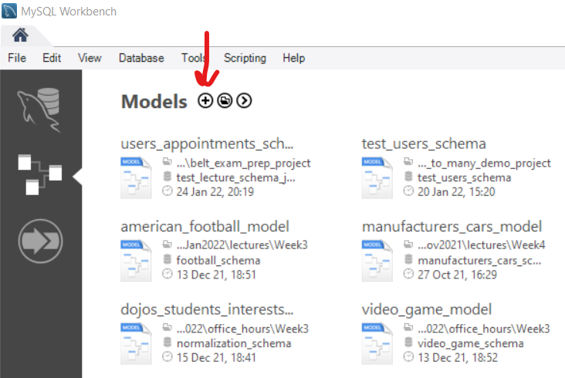
Creating an entity-relationship diagram (ERD) from scratch
Make sure MySQL Workbench is open first!
Select the icon with the tables connecting together:
Then click on the (+) sign next to the word “Models”:
This will allow you to create a new schema!
(To open up an old schema, just click on the one in
the list OR go to “File” -> “Open Model...”.)

Slide 18
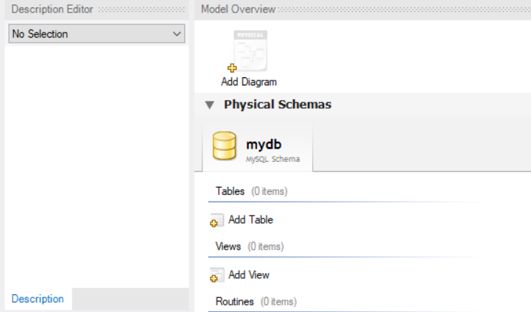
Creating an entity-relationship diagram (ERD) from scratch
You should now see this:
To change the name of your schema,
double-click on the tab that says “mydb”
(or a similar name) OR right-click,
then select “Edit Schema”.
Now in the Name text box, change the name as you see fit, then click “Rename References”. Click “OK” if you see a pop-up appear that says “Refactor Schema”.

Slide 19
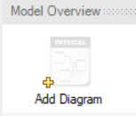
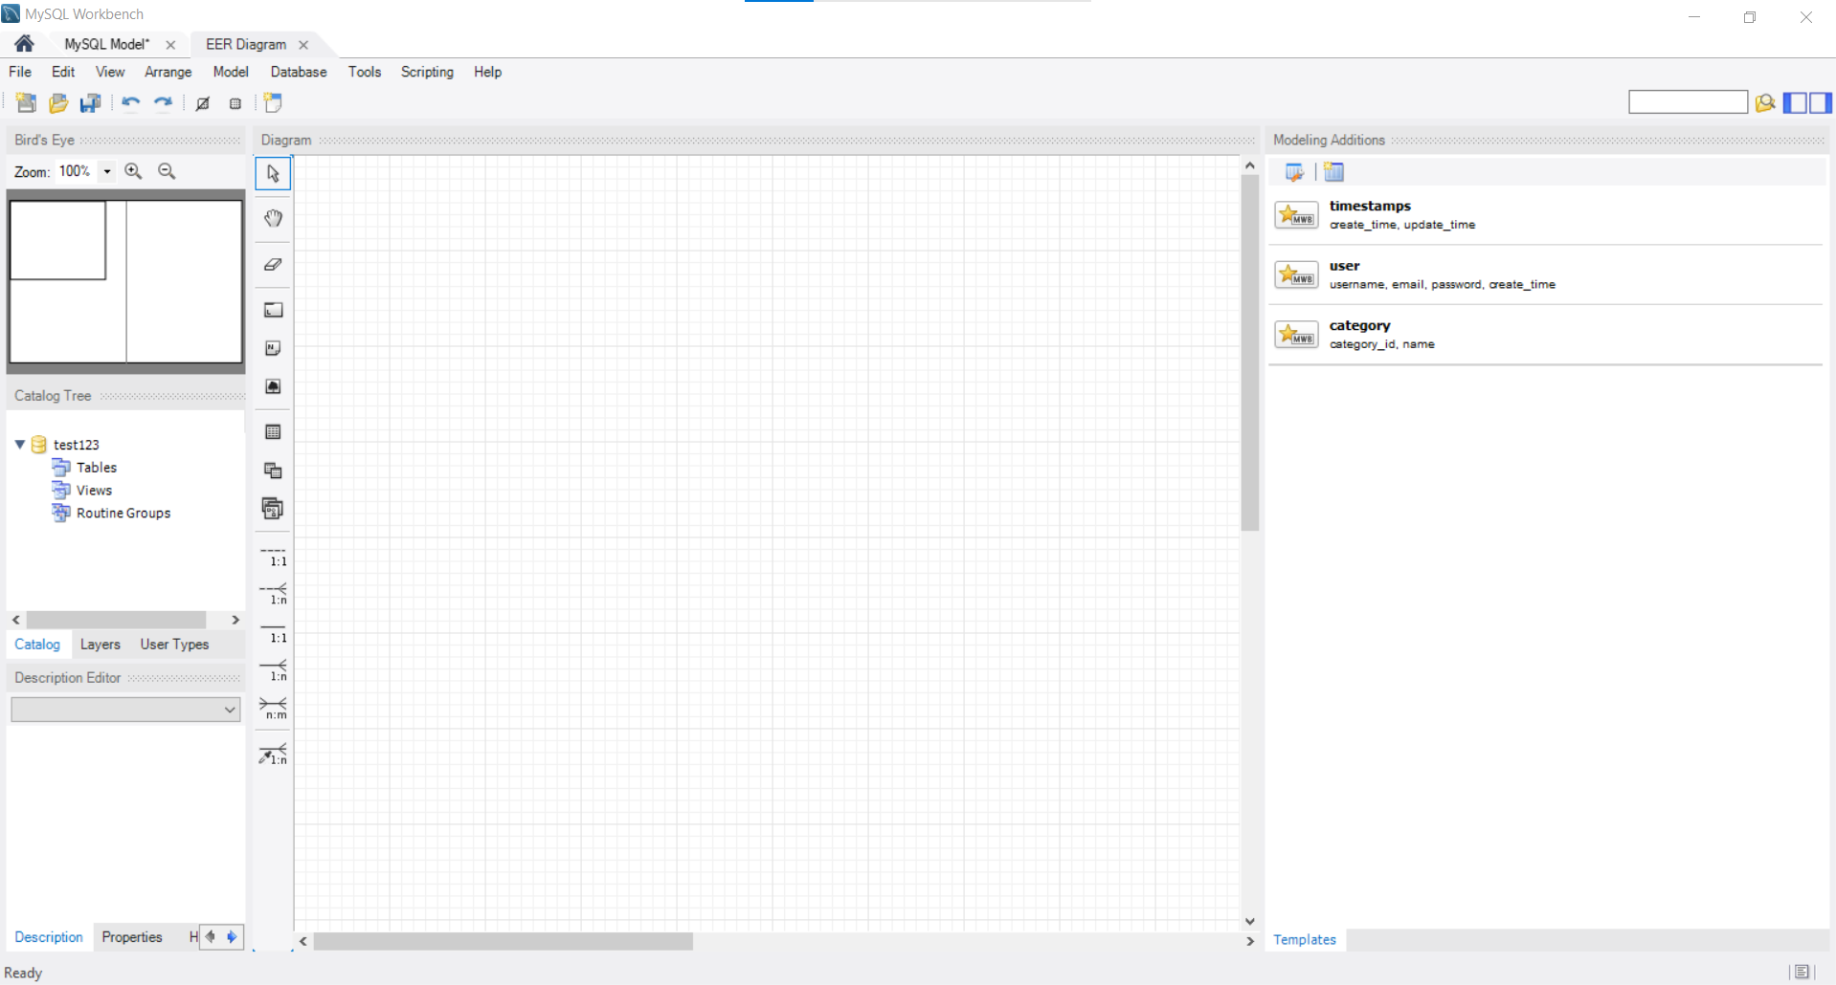
Creating an entity-relationship diagram (ERD) from scratch
Now that your schema name is set, you can build your diagram! Double-click on the “Add Diagram” icon:
You now should see a screen like this:

Slide 20
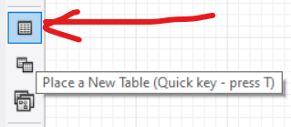
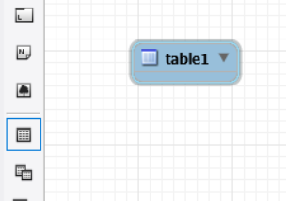
Creating an entity-relationship diagram (ERD) from scratch
There should be a set of icons on the left in the “Diagram” box. Select this icon to add a new table:
Now click anywhere in the diagram to place a new table. You should now see something similar to this:

Slide 21
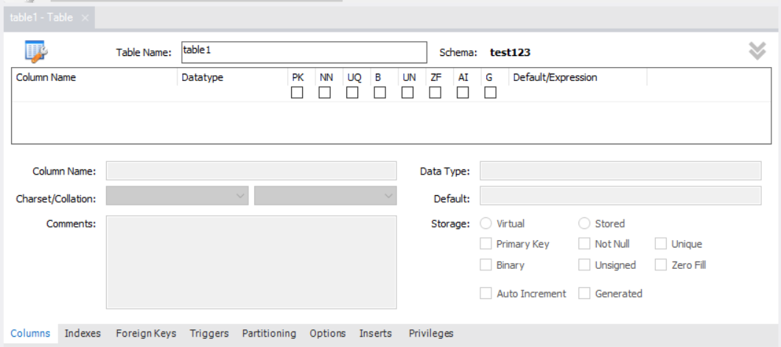
Creating an entity-relationship diagram (ERD) from scratch
Double-click on the table. Now you should see this pop up, likely at the bottom of your screen:

Slide 22
Data types
You will primarily be using these data types:
VARCHAR - allows up to 255 characters
VERY IMPORTANT - ALWAYS USE VARCHAR(255) if you use this data type!!! Don’t use the default value of 45!! This will be especially important when we save (hashed) passwords in your database soon, which will be more than 45 characters!
TEXT for long inputs that are more than 255 characters
INT for integers
DATETIME
DATE for just the date only (no time component, so no 5 PM, for example)
FLOAT for decimals
CHAR for fixed-length character fields only, like state abbreviations
(BLOB might come in handy for future projects)
More on other data types if you’re curious:
https://dev.mysql.com/doc/refman/8.0/en/data-types.html

Slide 23
Question 2
What data types should you use for these situations?
Savings account balance
An essay
Birthdate to the minute
Favorite food

Slide 24
Question 2
What data types should you use for these situations?
Savings account balance - FLOAT
An essay - TEXT
Birthdate to the minute - DATETIME (DATE if we only want month, day and year)
Favorite food - VARCHAR (likely not TEXT)

Slide 25
Default values
There will be fields where you might want to give everyone a starting value.
All your tables should have “created_at” and “updated_at” fields, which describe when a record was first created and when it was edited, respectively.
There might be other fields where giving a default value is appropriate. For example, if you have a database of bank accounts, you would want to give everyone a default starting value of 0 for the account balance.

Slide 26
Primary key
The primary key is used to uniquely identify each record (row) in your table. Usually this will be an id value.
In this example, the “id” column is used as the primary key:
So the record whose id is 3 refers to “Michael J. Fox”.

Slide 27
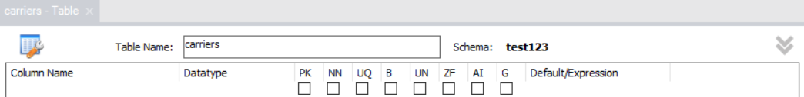
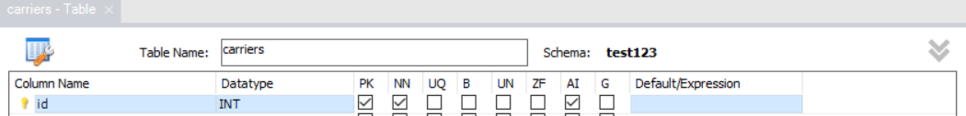
Begin building your tables!
Rename your table in the text box by “Table Name”:
The very first column to add should be your primary key, usually named “id”:
The name should be plural, like “users”, “authors”, “carriers”, “cars”, etc.
Now add your primary key, which usually will be named “id”:
IMPORTANT: Remember to select “AI” for auto-increment!!

Slide 28
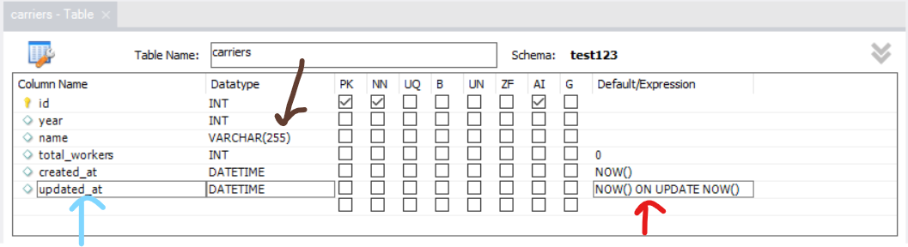
More table building
Now add additional columns as you see fit:
For VARCHAR(), remember to put 255!
Remember to add created_at and updated_at fields! Don’t forget default values!

Slide 29
Adding default values
Referring back to this:
You can add default values in the “Default/Expression” column. Type the following in the “Default/Expression” section for each of these columns:
created_at - NOW()
updated_at - NOW() ON UPDATE NOW()
Other columns - put in values such as 0, 1, etc. as you see fit

Slide 30
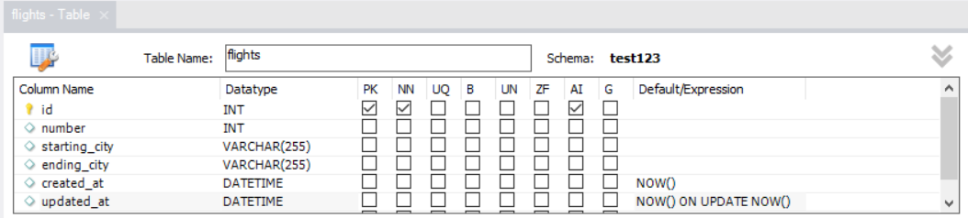
More table building
Add additional tables to your diagram as needed. Below is a second table called “flights”:
When you are done, it’s time to add foreign keys to connect tables where needed!

Slide 31
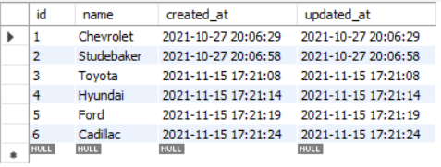
Foreign keys
A foreign key is used to connect one table to another. The value stored is the id from another table. You connect a foreign key in one table to a primary key in another table.
Below is a table of cars with a foreign key named “manufacturer_id”, which links a manufacturer to each car:
Here is the manufacturers table for
reference:
So the Camaro and Corvette are linked
to Chevrolet.

Slide 32
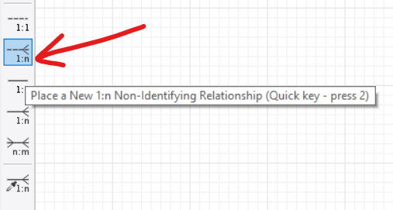
Adding a foreign key
(one-to-many relationship)
In the “Diagram” box, select the dashed “1:n” option. (The solid “1:n” option is for identifying relationships, which we’ll not cover here.)

Slide 33
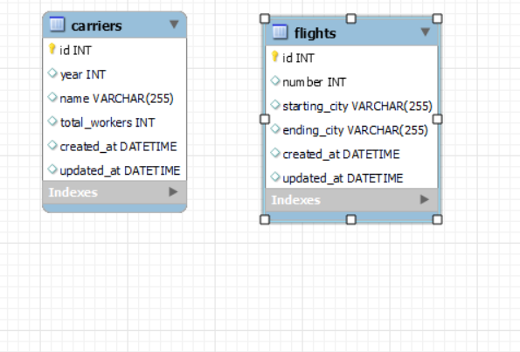
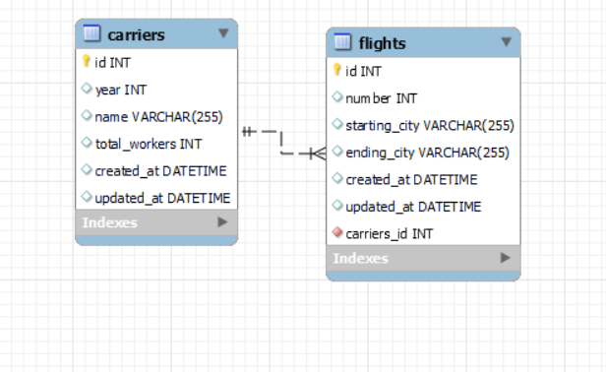
Adding a foreign key
(one-to-many relationship)
Click on the many table first - so in the example below, the “flights” table. Then click on the one table, in this case the “carriers” table. (The “many table” is the many side of the one-to-many relationship, and vice versa.)
BEFORE:
AFTER:

Slide 34
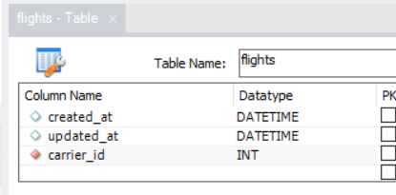
Adding a foreign key
(one-to-many relationship)
Double-click on the many table to edit it. Change the name of the foreign key to the singular - so for example, instead of “carriers_id”, type “carrier_id” (notice the “s” is gone).

Slide 35
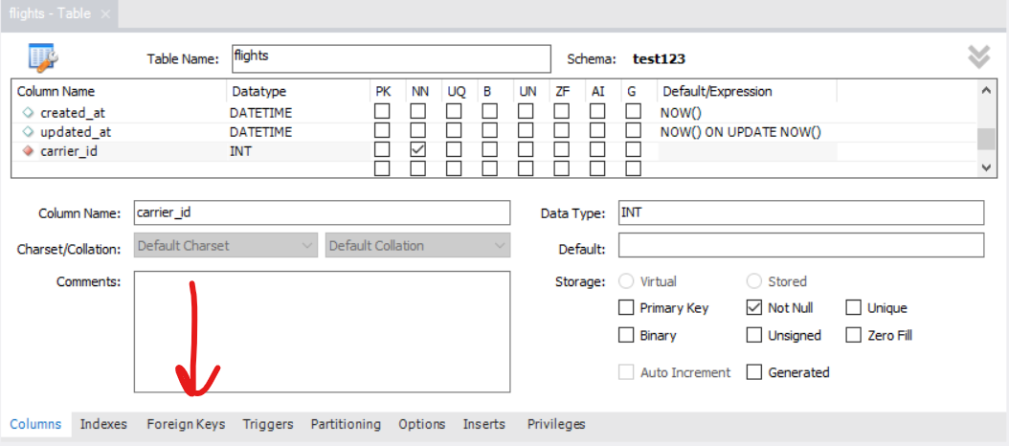
Adding a foreign key
(one-to-many relationship)
Click on the Foreign Keys tab at the bottom:

Slide 36
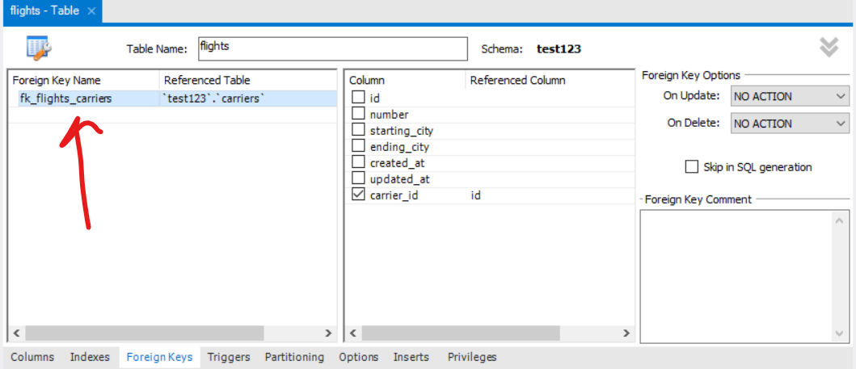
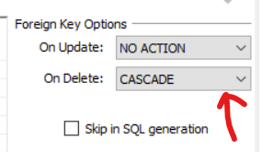
Adding a foreign key
(one-to-many relationship)
Click the foreign key name on the left:
IMPORTANT for ALL foreign keys in ALL relationships:
Now change the “On Delete”
from “NO ACTION” to “CASCADE”.

Slide 37
Adding a foreign key
IMPORTANT for ALL foreign keys in ALL relationships:
Now change the “On Delete” from “NO ACTION” to “CASCADE”.
For example, if you were to delete a carrier, you delete all the flights linked to it. Otherwise you run the risk of encountering issues with foreign keys!

Slide 38
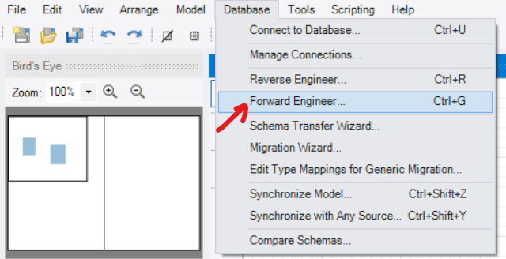
Forward engineering
When your tables are all set, you can now forward-engineer your schema! This will actually allow you to store data now that your design is ready.
Go to “Database” -> “Forward Engineer…”.

Slide 39
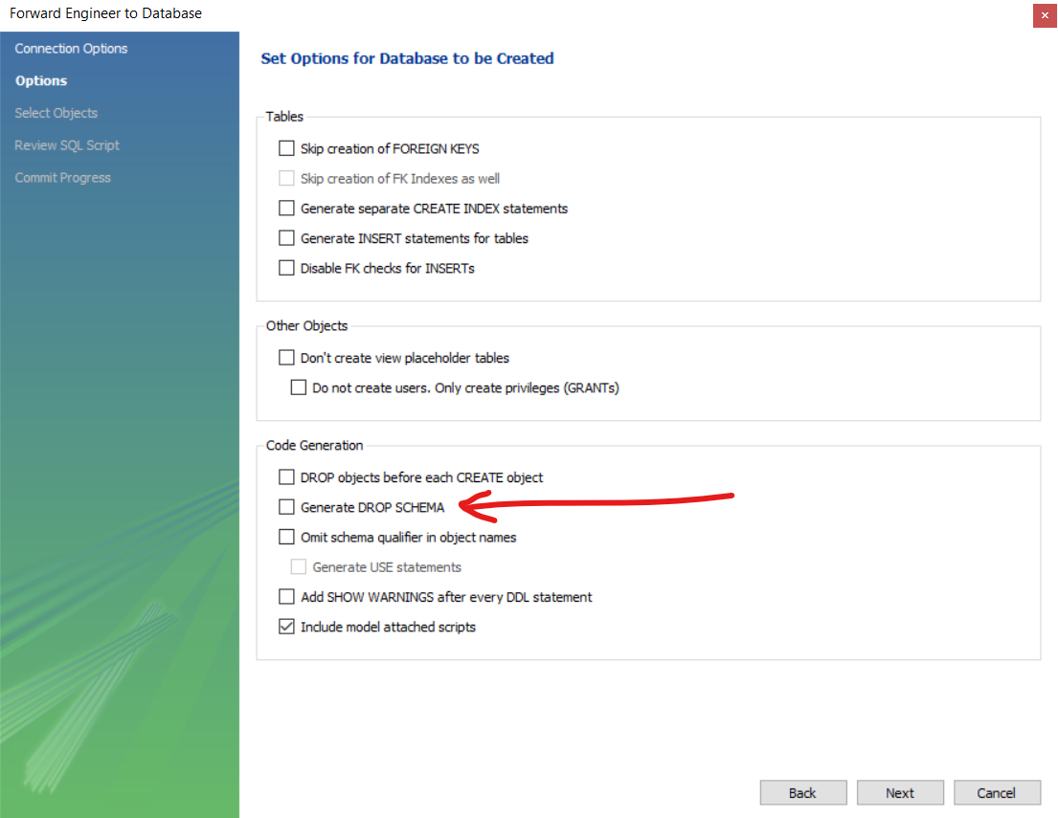
Forward engineering
Go ahead and click “Next”. (You might have to enter your password.)
At this step, if you are starting over
with your database, select
“Generate DROP SCHEMA”.
NOTE:
This will delete your old database, so
you will lose your data!

Slide 40
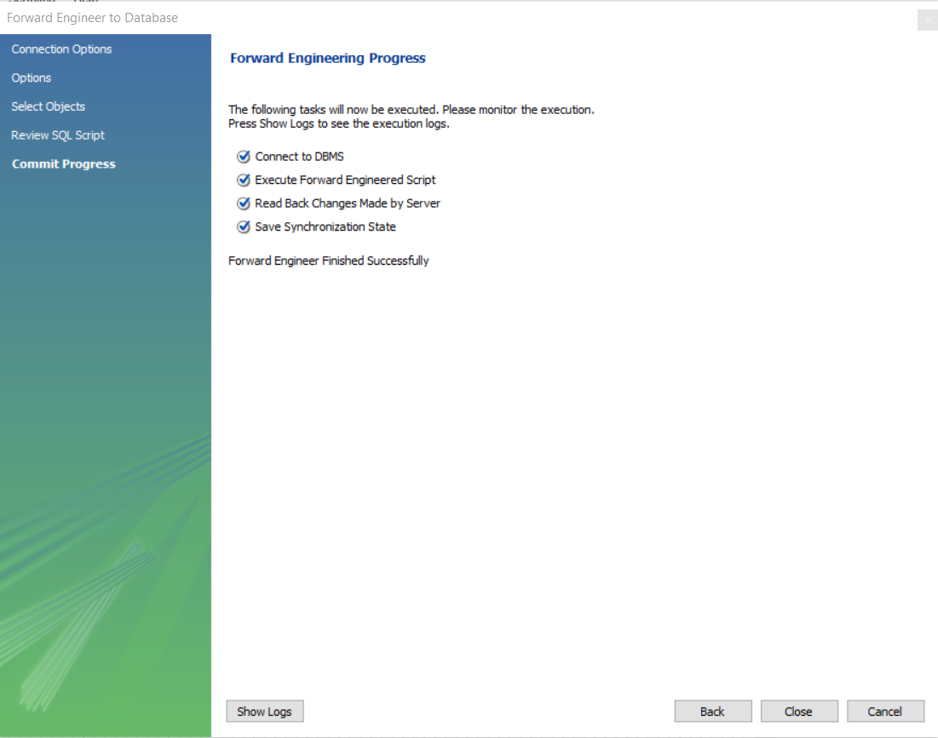
Forward engineering
Continue clicking “Next”. If it’s successful, you should see this:
Now click “Close”. You’re all set!

Slide 41
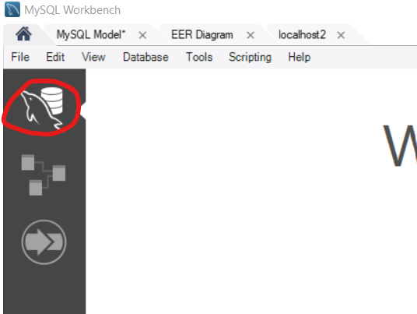
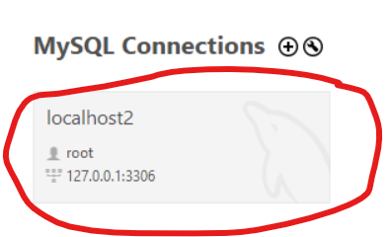
Opening your database
Open your database up by clicking the dolphin with disks icon from the home screen (click the Home icon first if needed). Then click on “localhost” or whichever is holding your databases:

Slide 42
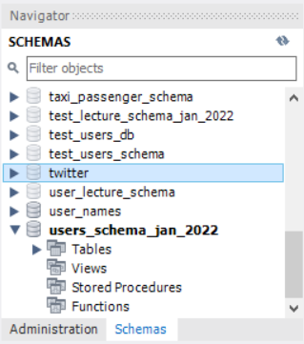
Viewing your databases
You should now see a SCHEMAS sidebar.
Double-click on a schema to open it up
and make it the active one!
(You might need to click the “refresh” icon beforehand.)
Here, the users_schema_jan_2022 schema is selected
as an example.

Slide 43
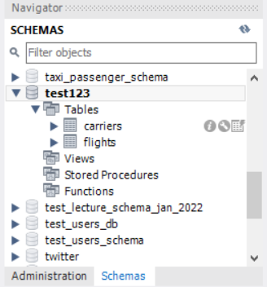
Viewing your databases
Click on “Tables”, then hover over any table:
In the picture below, I’m hovering over the “carriers” table. Notice the icons to the right of the table name.
The “i” is for information.
The “wrench” is for editing your tables afterwards
(NOT for editing data).
The icon with the table and the lightning bolt is for
viewing the data in the table. (We’ll talk about that
more in the next lecture.)

Slide 44
Editing your databases afterwards
You can go back to your model file and edit your columns accordingly. NOTE: You MUST select “Generate Drop Schema” for this to work; not selecting it will not automatically update your tables.
In local host, click the “wrench” icon (see previous slide). Now you can edit as you see fit. NOTE: This will NOT update your tables in your model file.

Slide 45
Bonus/group exercise

Slide 46
Design your own ERDs!
Pick any of these - or use your own, as long as it has a one-to-many relationship:
Carriers and flights
States/provinces and cities
Museums and relics
Now make two tables. Make sure they both have the following:
A primary key named “id” (don’t forget to auto-increment!!)
created_at with a default of NOW()
updated_at with a default of NOW() ON UPDATE NOW()
At least one VARCHAR, INT and TEXT column - you decide what columns you want; as long as there’s a minimum of one of each type
Make sure your many table (in the one-to-many relationship) has a foreign key!
Answers will vary. Have fun with this!

